Slide 1
Observer and Mediator Pattern

Slide 2
Observer Pattern
Observer pattern is used when there is one-to-many relationship between objects such as if one object is modified, its dependent objects are to be notified automatically.
The Observer Pattern provides an object design where subjects and observers are loosely coupled. WHY? How?
Observer pattern falls under behavioral pattern category.

Slide 3
Observer Pattern
Observer pattern uses three actor classes. Subject, Observer and Client.

Slide 4
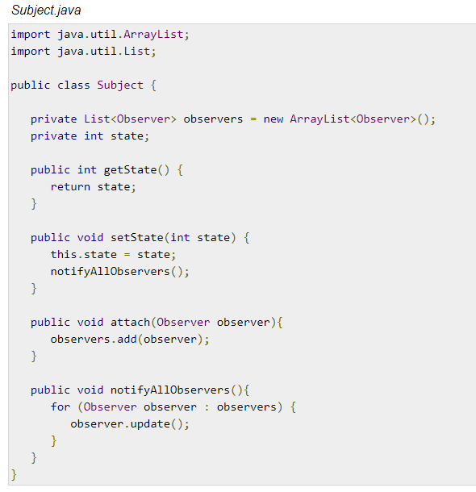
Observer Pattern

Slide 5
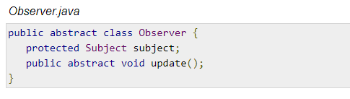
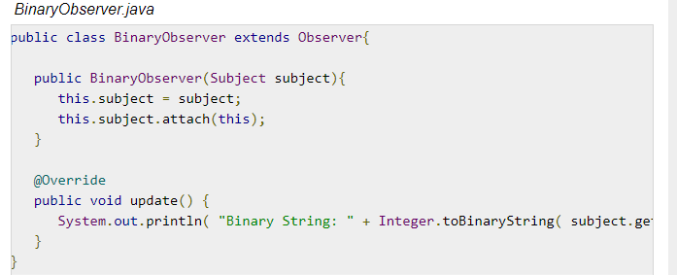
Observer Pattern

Slide 6
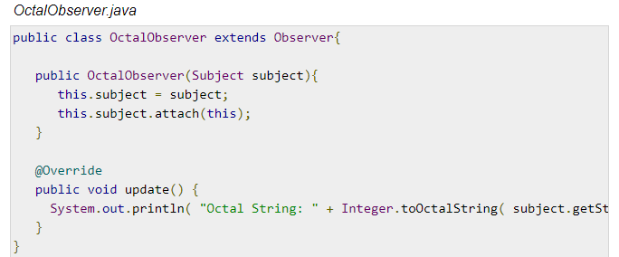
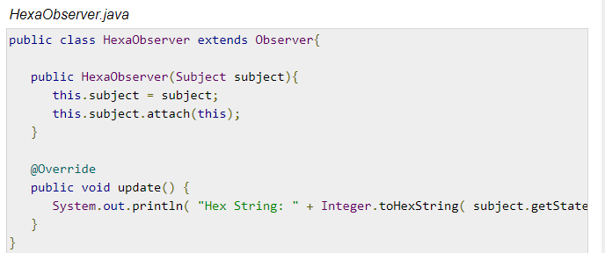
Observer Pattern

Slide 7
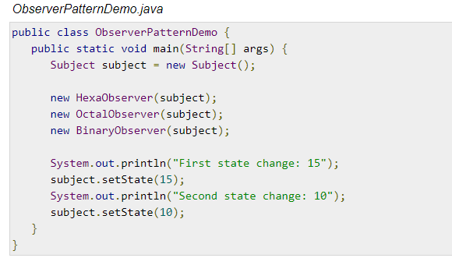
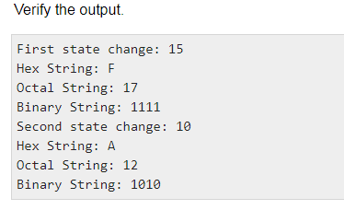
Observer Pattern

Slide 8
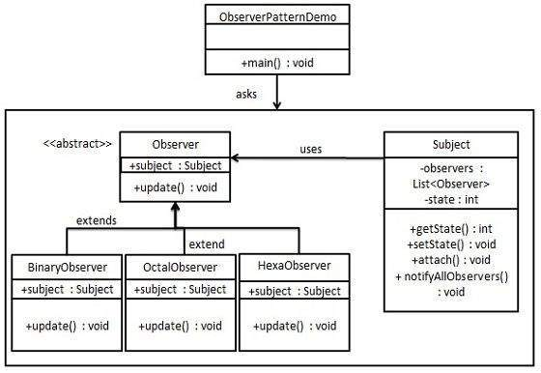
UML Diagram for the Observer Pattern

Slide 9
Problem
What if the relationship is many-to-many?

Slide 10
Mediator Pattern
Mediator pattern is used to reduce communication complexity between multiple objects or classes.
This pattern provides a mediator class which normally handles all the communications between different classes and supports easy maintenance of the code by loose coupling.
Mediator pattern falls under behavioral pattern category.

Slide 11
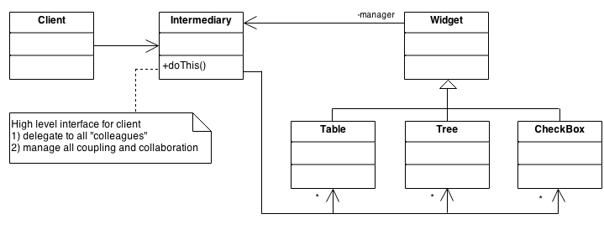
Mediator Pattern

Slide 12
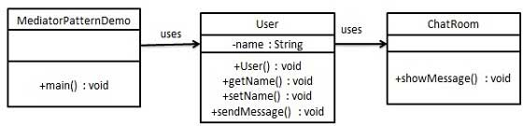
Mediator Pattern

Slide 13
HW
Learn writing a code on mediator.
Think on the situations where we can use observer or mediator pattern.
Differences between observer and mediator.

Slide 14
HW
Prepare a 3 minute presentation on you assignment 1 (combining strategy, factory and abstract factory)

